Slide 1
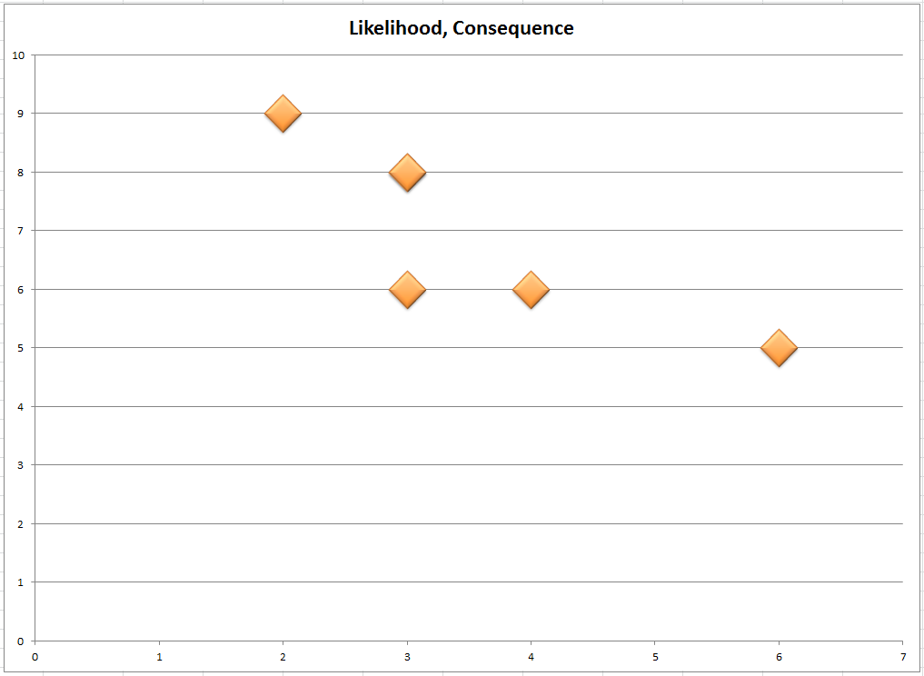
L
High Risk
6
4
2
5
3
1
Medium Risk
Low Risk

